Slide 1



Digital Radio Mondiale
South Africa
ORAL REPRESENTATION ON THE 2nd DRAFT NATIONAL RADIO FREQUENCY PLAN (NRFP-2025)
16 JANUARY 2026

Slide 2
INTRODUCTION
The DRM consortium welcomes the work ICASA has done on the second draft of the National Radio Frequency Plan (NRFP-2025)
The DRM Consortium thanks the regulator for incorporating the majority of its comments from the first draft NRFP-2025.
We would like to highlight the salient points from our written submission on the second draft of the NRFP-2025.

Slide 3
Who are we?
Founded in 1998 by international organisations to promote the adoption of the DRM standard worldwide
Not-for-profit organisation
Around 100 international members Broadcasters, manufacturers, network operators, regulators, research institutes, etc…
Experts and technologists Ready to give expert and objective advice on the technology
Open to all
Companies, organisations, associations and individuals can join at any time.
SA GROUP OBJECTIVES
Advocate the use of DRM as the preferred standard for digital sound broadcasting in South Africa
Create Awareness of DRM with the general public, stakeholders, suppliers, manufacturers, retailers and all government entities
Influence industry and stakeholders on the use of DRM
Be the credible Authority on the DRM standard in South Africa (the knowledge hub for everything DRM related)
For joining the DRM group, write to: projectoffice@drm.org

Slide 4
DRM Terminology – One Standard
DRM is a single ITU-R standard with DRM30 and DRM+ being operational modes
DRM30 for LW / MW / SW (<30 MHz) bands and DRM+ for VHF bands (incl. FM)
We acknowledge the use of these terms by ICASA in a practical spectrum planning context.
We respectfully request the regulator to clearly differentiate between the unified standard and operational modes in the final NRFP-2025.

Slide 5
The Use of Long Wave
We acknowledge the reasons ICASA may have for not including DRM as an application in the LW frequency bands;
Global decline in LW broadcasting usage &
High infrastructure costs
The propagation characteristics of LW, particularly over sea – ideal for future maritime automated weather warnings, NAVDAT messaging & transmission of graphics such as sea-state charts.
We respectfully request ICASA to include DRM as a recognized application in the LW broadcast bands to enable such services in future.

Slide 6
VHF Band III – Forward Looking
We welcome the proposed study to identify the highest value uses and develop RFSAP
Whilst DAB+ has been allocated 214-240 MHz, DRM + can work across VHF band III
Both DAB and DRM are recognised by ITU. We therefore respectfully request that DRM be included in this band. Equipment exists for transmitting and receiving DRM in
This will ensure the NRFP-2025 is future proofed.
We once again confirm our offer to assist with DRM technical expertise, regulatory input and information on trails & case studies in other member territories.

Slide 7

CONCLUSION
Thank you for allowing us to participate in this important process.
We remain committed in supporting the regulator with DRM facts and expertise.

Slide 8
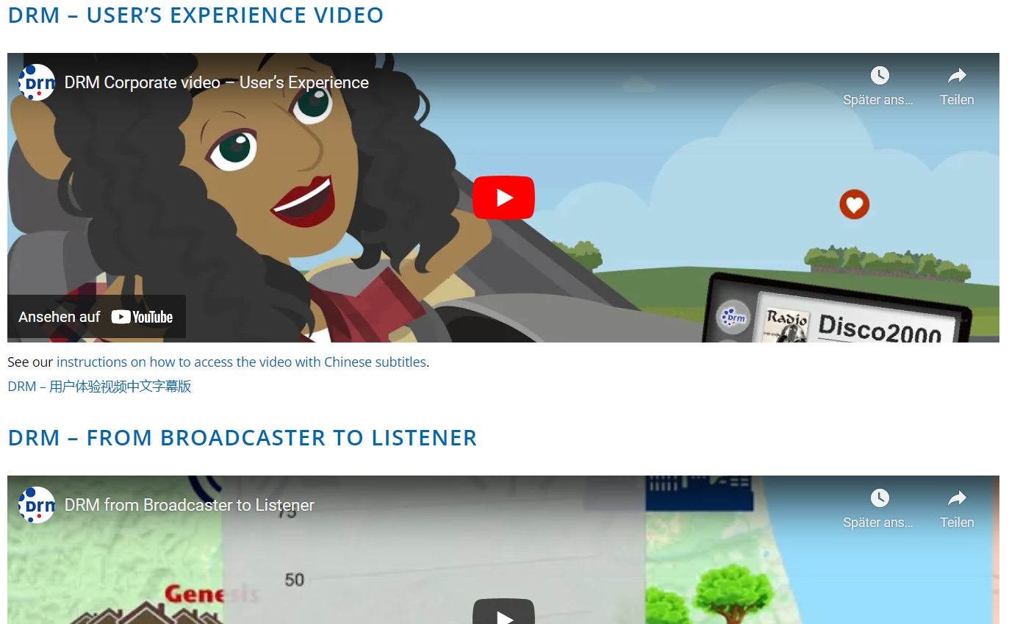

DRM Smart Radio Benefitting All Listeners
To access information on specific DRM subjects
type in your browser:
pocket.drm.org
Watch the DRM Corporate Videos:
videos.drm.org
Additional videos on DRM YouTube channel:
youtube.drm.org

Slide 9
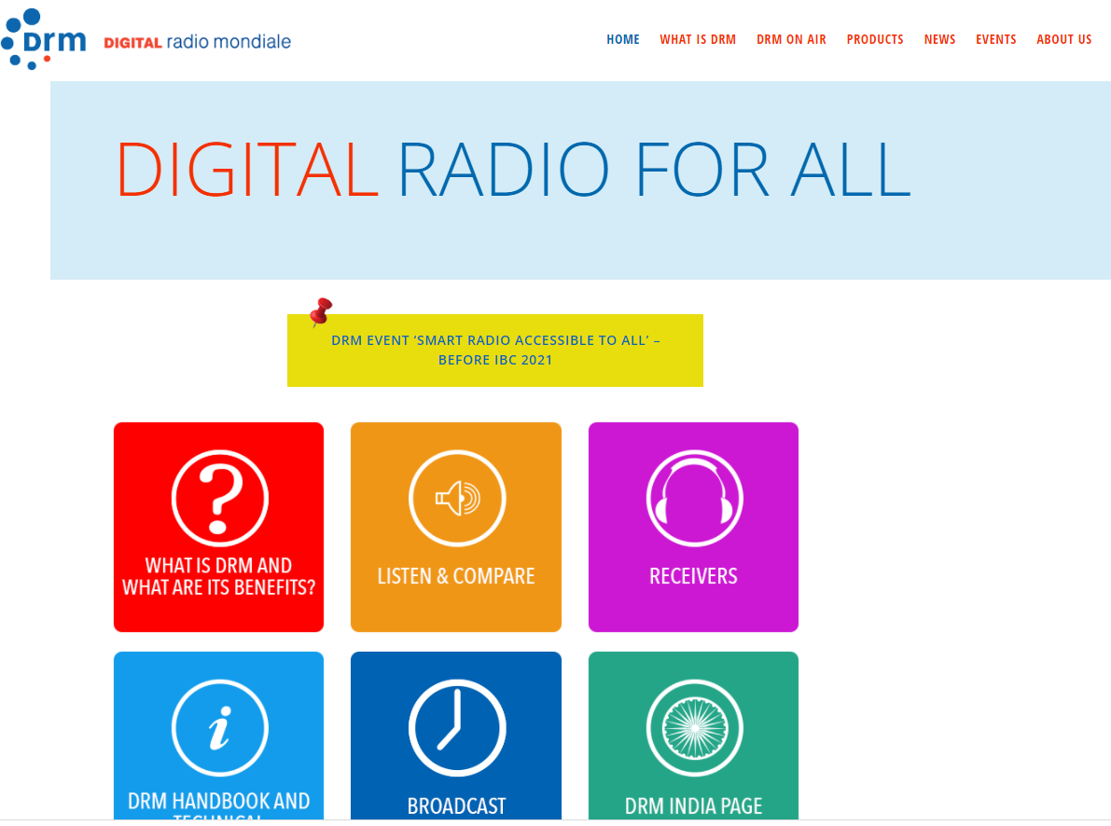




DRM Smart Radio Benefitting All Listeners
For free monthly DRM updates visit and subscribe to: newsletter.drm.org
Dedicated India page
india.drm.org
For any inquiries or comments, please write to: projectoffice@drm.org
Follow: @drmdigitalradio
Follow: @drmdigitalradio
youtube.drm.org

Slide 10
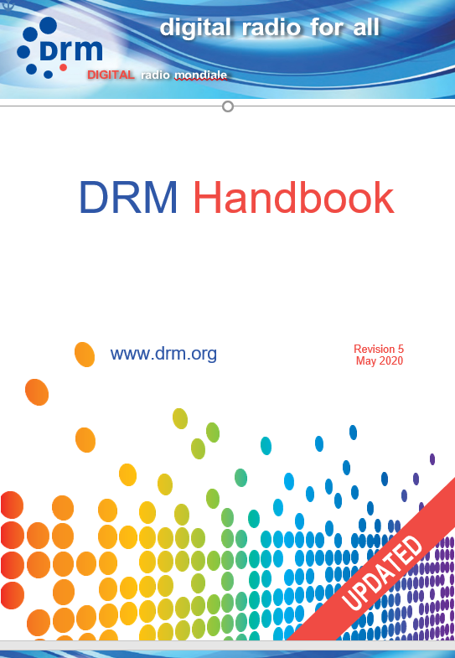
All you need to know about DRM Digital Radio
DRM Handbook Version 5 Free download from: handbook.drm.org
All DRM Information at your fingertips: pocket.drm.org

