Slide 1

KisimaRadio
“Heart to Heart Communication”
Company Profile

Slide 2
Content
Purpose
Problem
Solution
Product
Why now?
Market Potential
Team
Business Model
Financials
Highlights
Contacts

Slide 3
Purpose
The purpose of this radio broadcasting and communications service is to create a platform that will facilitate the restoration of mankind’s identity back to God’s original intent through communication resulting in communities that co-exist and co-create with God.

Slide 4
Problem
According to the last Census conducted in 2016 South Africa’s population was at 55,6 million and the Youth made 36,2% of the population equating to 20,1 million. Amongst the top 5 challenges at Municipal level were “lack or inadequate employment opportunities” which occupied the 2nd highest challenge and “crime” which occupied the 5th challenge. The number of households who experienced crime was 7.5% of the population. These gruesome statistics make a strong case for KisimaRadio’s vision which is “to facilitate the restoration of mankind back to God’s original intent through communication”.
At KisimaRadio we believe that an individual’s lack of identity results in misplaced decisions being made about every aspect of their lives especially at a vocational and behavioral level. According to an article published by Business Tech dated 12/05/2016, South Africa had a total of 296 stations both commercial/public and community, with such accessibility to information one would think citizens would be engaged on matters relating to identity but the focus has been and continues to be largely on hard skills neglecting the criticality of engaging communities on topics relating to identity and self.

Slide 5
Solution
The solution provided by KisimaRadio is structured in alignment with the definition of the name “Kisima” which means “the well/fountain”. The solution is split into 12 fountains each representing a key focus area that will be supported by complimentary features all linked to the main fountain (KisimaRadio). The objective of each fountain is to drive focus and accountability as each fountain embarks on a journey that will transform communities towards God’s original intent for mankind in that specific fountain.
The below represents the main stakeholder groups that will be addressed by the respective fountains:
Person, Family & Community
Government
Business/Market Place

Slide 6
Solution
Person, Family, Community
The intention of KisimaRadio is to act an enabler through communication restoring individuals to God’s purpose for their existence on earth. The restoration that will be taking place at an individual level will result in transformed families and communities that will become co-creators with God.
Government
Our vision is to collaborate with government rather than challenging the system, we believe that enabling communities will result in a South Africa that has appreciation of every resource available to them. Currently there is a very consumptive view of resources and we believe this is due to lack of identity.
Business/Market Place
South Africa has been hit with recession over the last year or two and as a result of this entrepreneurship has been identified as a key solution to mitigate this challenge. We believe that the market place could be a thriving space if entrepreneurs understand their identity as this will lead to the right decisions regarding business. In addition to this approach we believe that the market place is challenged with staff turnover due to employees that lack identity leading to poor vocational choices.

Slide 7
Product
Radio Broadcasting & Communication
This pillar will offer tailored & customized high quality programming with need centred content intended address specific challenges at an individual, family and community level. The distribution of content will be driven by a communication strategy that takes into account each target group dynamics such as location, age, infrastructure, learning styles, socio economic challenges etc
Social Enterprising
This pillar focuses on the provision of income generating opportunities to meet the basic needs of communities. At KisimaRadio we believe a critical success indicator for the service is in how well we maximize benefits to society whilst maximizing profits. Through strategic partnership we aim to define & implement a funding strategy to support social programs that are aligned to the vision of KisimaRadio.
Community Transformation Initiatives
This pillar focuses on the identification of initiatives that will be implemented in collaboration with stakeholders, the emphasis will be on the following groups: youth, children, women, people living with disabilities, orphans, child headed families, vulnerable young and old men, homeless people, senior citizen and local business. The stakeholder groups will be defined through a mapping process intended to guide the organization’s collaboration decisions.

Slide 8
Why now?
Unemployment
In Q3 of 2019 unemployment was reported at 29,1%;
Crime
As at 02/09/2019 58 people are murdered each day and between 2017-2018 the statistics were 35,2 per 100 000.
Youth Pregnancy
Teenagers account for 10% of deliveries in SA;
16 million pregnancies were recorded for youth between 15-19 years old and 1 million of these were under the age of 15 years.
Age group 15-24 years made up 55,2% of the 29,1%;
In the age group of 15-24 years, 31% were graduates.

Slide 9
Market Potential
Social Media
27 million represents the total addressable market across Facebook, Instagram and Twitter in South Africa.
Facebook = 16.2M
Instagram = 3.63M
Twitter = 8.3M
Radio
71k represents the proposed radio coverage in the Khayelitsha area only.
Online
27M
Social Media
71k
Radio
100k
Online

Slide 10
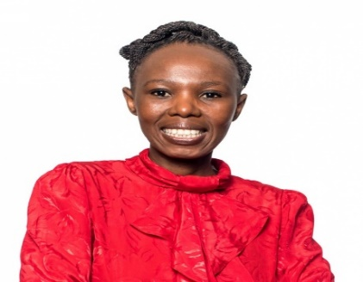
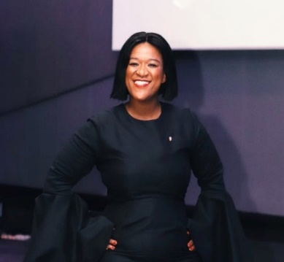
Meet the Team
Miss Maria Ntombizamahlubi Msesi is a qualified Forensic Analyst who is currently employed in the Chemistry Unit of the South African Police Services at the Forensics Science Laboratory in Cape Town, Plattekloof. She has spent over a decade at Radio Tygerberg a Cape Town based community radio station where she started as a freelance presenter, this platform has allowed her to learn about the operational and strategic aspects of a community radio station. Over the years she developed an inner drive to make impact in transforming people’s lives through radio which motivated her to invest her personal time in conducting research about the radio industry and explore creative ways to bridge existing gaps hence her involvement in KisimaRadio.
Maria’s analytical skills coupled with her tenacity and passion for radio brings invaluable contributions to KisimaRadio.
Miss Nonkoliseko Rwanqa holds a National Diploma in Cost and Management Accounting accompanied by a Certificate in Public Management Fund Act. She currently occupies a role in the Finance Division of the National Student Financial Aid Scheme. Her work experience has been predominantly in the Finance and Media areas of work. She has briefly volunteered a Tygerberg 104 FM where she assisted the team with event coordination and community outreach which gave birth to her passion for Youth Development.
She is a creative thinker with an ability to come up with actionable ideas on how to develop and build communities which fully supports KisimaRadio’s mandate.

Slide 11
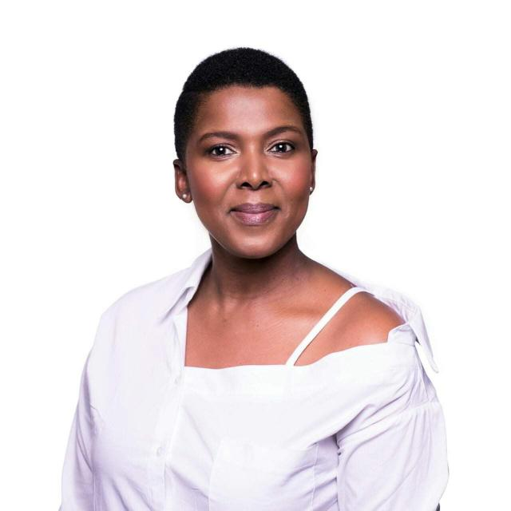
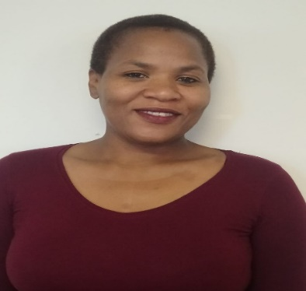
Meet the Team
Miss Nosipho Patricia Mahlanyana, a qualified community counsellor and a community developer, has been working in the radio industry for at least 8 years of which the first 3 years were on ad hoc basis as a studio guest, then later landed a position as an anchor presenter at Radio Tygerberg. Her interest and passion to do community development work though radio ushered her into her last position as a HOD for isiXhosa programmes at Radio Tygerberg.
Over and above her 12 years’ experience of travelling locally and internationally, her current studies BA (International Relations) are shaping her mind and heart to realise how critical it is for Africans, in this generation to strive for the restoration of Africa in all aspects. She brings to TWF her strength in identifying existing gaps in communities, creativity, planning and ability to negotiate support and or business from relevant stakeholders and or potential investors.
Miss Norma Patricia Ndingane a qualified land surveyor, currently employed by City of Cape Town (land and restitution). Her passion for business prompted her to advance her business skills and she enrolled for short courses in, project management, planning and organisational skills, supervisory and time management skills to mention but a few.
She brings to TWF her strength in critical thinking, strong organisational skills, professional service delivery and task/goal orientated. She has flair in business negotiations.

Slide 12
The Business Model
Key Partners
Key Activities
Value Proposition
Customer Relationship
Customer Segments
Key Partners
Business
NPOs
Government
Communities
Radio & Online Broadcasting
Social Enterprising
Community Initiatives
Online & Print Communication
Advertising
Communication Platform designed for Communities, Business & Government to facilitate the restoration of Mankind.
Self-Service
Co-creation
Dedicated Assistance
Collaboration
KisimaRadio has 3 main customer segments namely, Communities, Business/Market Place and Government.
These customer segments all generate revenue for the business in various ways.
Resources
Intellectual Property
Finance
Access to Markets
Infrastructure
Key Resources
Channels
Money
Funders, Investors, Sales & Sponsorships
Knowledge/Skills
Legal, Business, Risk & Compliance
Social Media
Digital
Radio
Print Media
Educational Institutions
Faith-based Organisations
Community Events
Key Suppliers
ICASA (licensing)
ICT
Professional Services
Cost Structure
Revenue Streams
Fixed Costs
Salaries
Rental & Lease
Insurance
Transmission Fees
Utilities
Licensing & Accreditation
Corporate Merchandise (Sales)
Syndication of popular programs
Selling newscasts to other Radio stations
Variable Costs
Professional Services
Ad-hoc Services
Banking Fees
Commissions
Memberships
Pledges
Ad Sales
Transaction-based
Events

Slide 13
Financials

Slide 14
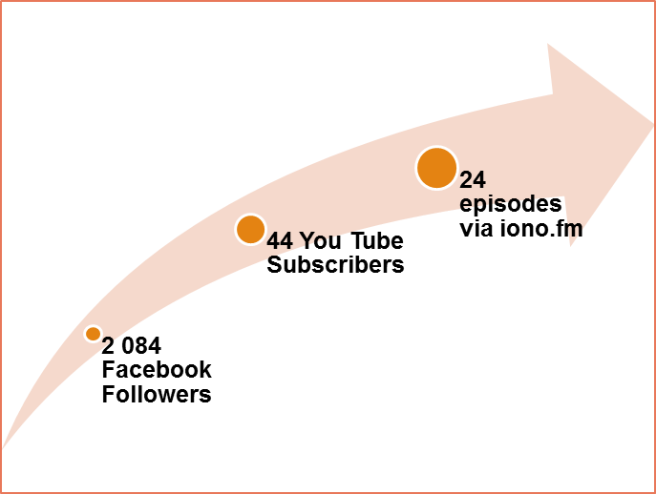
Highlights
The below performance is a good indicator that when KisimaRadio commences with Radio Broadcasting the numbers will certainly increase. It is indicative of the importance of the role played by KisimaRadio.
Facebook
Over a period of 10 months we’ve gained 2 084 followers which equates to 208 followers per month.
You Tube
Though the number of subscribers is 44 over a period of 9 months this number equates to an average of 5 subscribers per month. The total number of videos uploaded is 46 videos to date with a total of 1 300 views.

Slide 15



Contact Us
ADDRESS
KCT Show Village, Erf 75813
Walter Sisulu Drive
KHAYELITSHA,
Cape Town
South Africa
7490
PHONE
Primary: +27 84 554 7139
Secondary: +27 73 246 0048
EMAIL:
nosipho@kisimaradio.co.za

